Slide 1

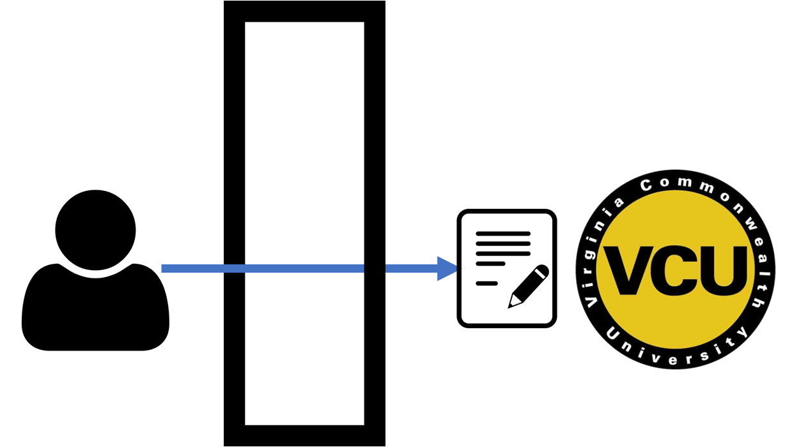

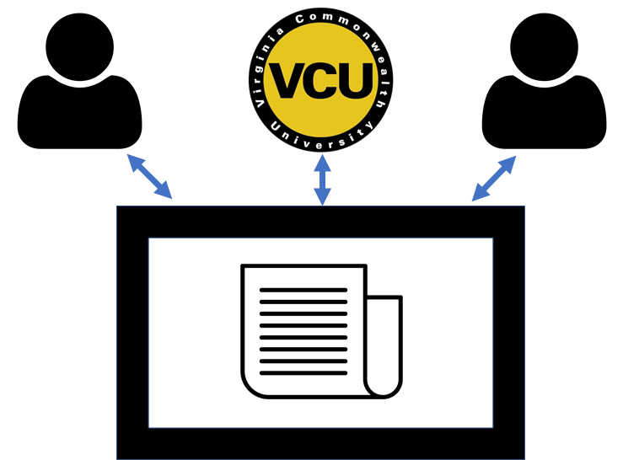


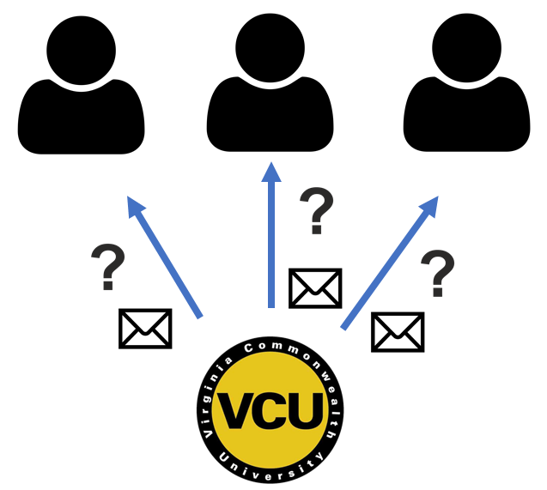
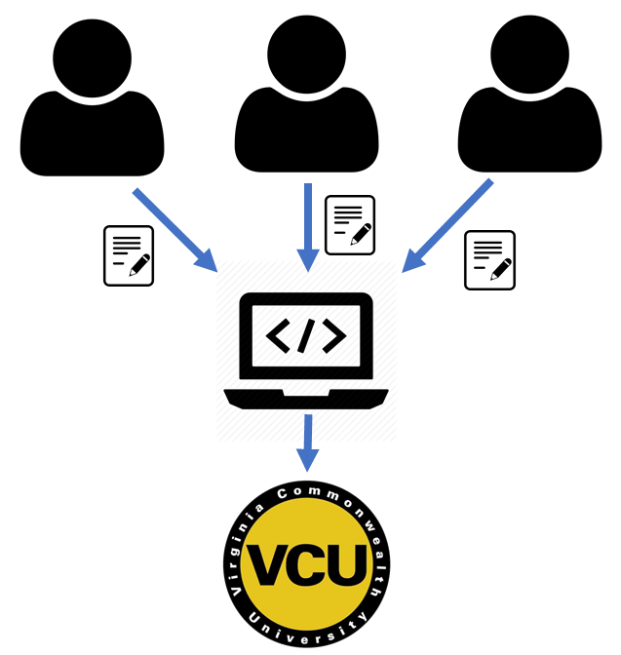


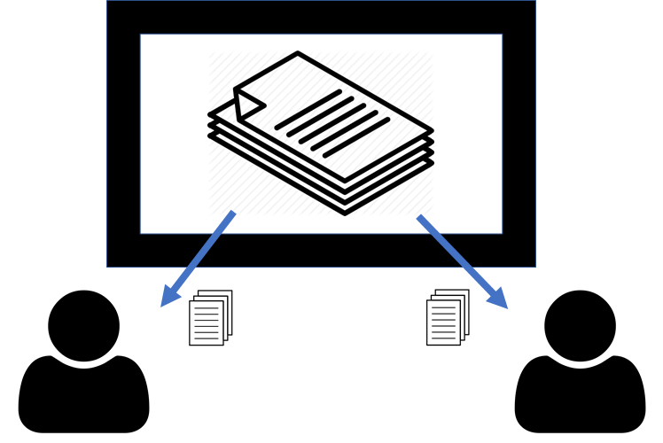






313
Teaching Assistant Management System
Team members: Abigail Byram, Neil Watson, Matthew Pointer, Matthew Tran | Faculty adviser: Caroline Budwell | Sponsor: VCU Dept of Computer Science | Mentor: Debra Duke
Problem Statement
Undergraduate teaching assistants (TAs) are a major resource in courses, but TA management is currently handled manually and is not scalable. A management system is needed to most effectively utilize TAs and allow courses to function smoothly.
Old Process
New Process
TA Recruitment
Students do not know how to apply to be a TA
Application available through web portal
Objectives
Automate the manual processes for TA recruitment, scheduling, and overseeing grading
Enable communication between TAs and Professors
Improve the scalability and quality of CS education
Training and Information Sharing
TAs trained individually often through email
TA onboarding and training information available in a centralized location
Solution Outline
Web interface: a centralized portal for TAs, professors, and administrators
TA Handbook: information and policy for the duties and expectations of TAs
TA – Class Matching
Manual emails required to check TA availability
TAs prompted each semester for updates and TA assigned to course within the app
TA Grading Supervision
Difficult to record grading progress and multiple graders cause inconsistency
Grading can be assigned in the web application and progress is recorded
Storage system: stores long term TA and course information
Automated Notifications: notifies and requests information updates

